Slide 1
EMPLOYEE DATA ANALYSIS USING EXCEL
STUDENT NAME: MASLINDA E
REGISTER NO: 312209491
DEPARTMENT: BCOM BANK MANAGEMENT
COLLEGE: ANNA ADARSH COLLEGE FOR WOMEN

Slide 2
PROJECT TITLE
Employee Performance Analysis using Excel

Slide 3


AGENDA
Problem Statement
Project Overview
End Users
Our Solution and Proposition
Dataset Description
Modelling Approach
Results and Discussion
Conclusion
3/21/2024 Annual Review

Slide 4

PROBLEM STATEMENT The employee performance analysis is conducted as it plays a major part in the growth of the organization. Employees performing very good will be awarded with bonus, increments and promotions whereas low performing employees will be motivated to work more effectively.

Slide 5

PROJECT OVERVIEW
Employee data analysis refers to analyzing the performance for each employee by considering various factors such as performance score, gender, ratings, achievements, performance level. This is done for the purpose of analyzing the trends of different categories of employees like high, medium and low.

Slide 6
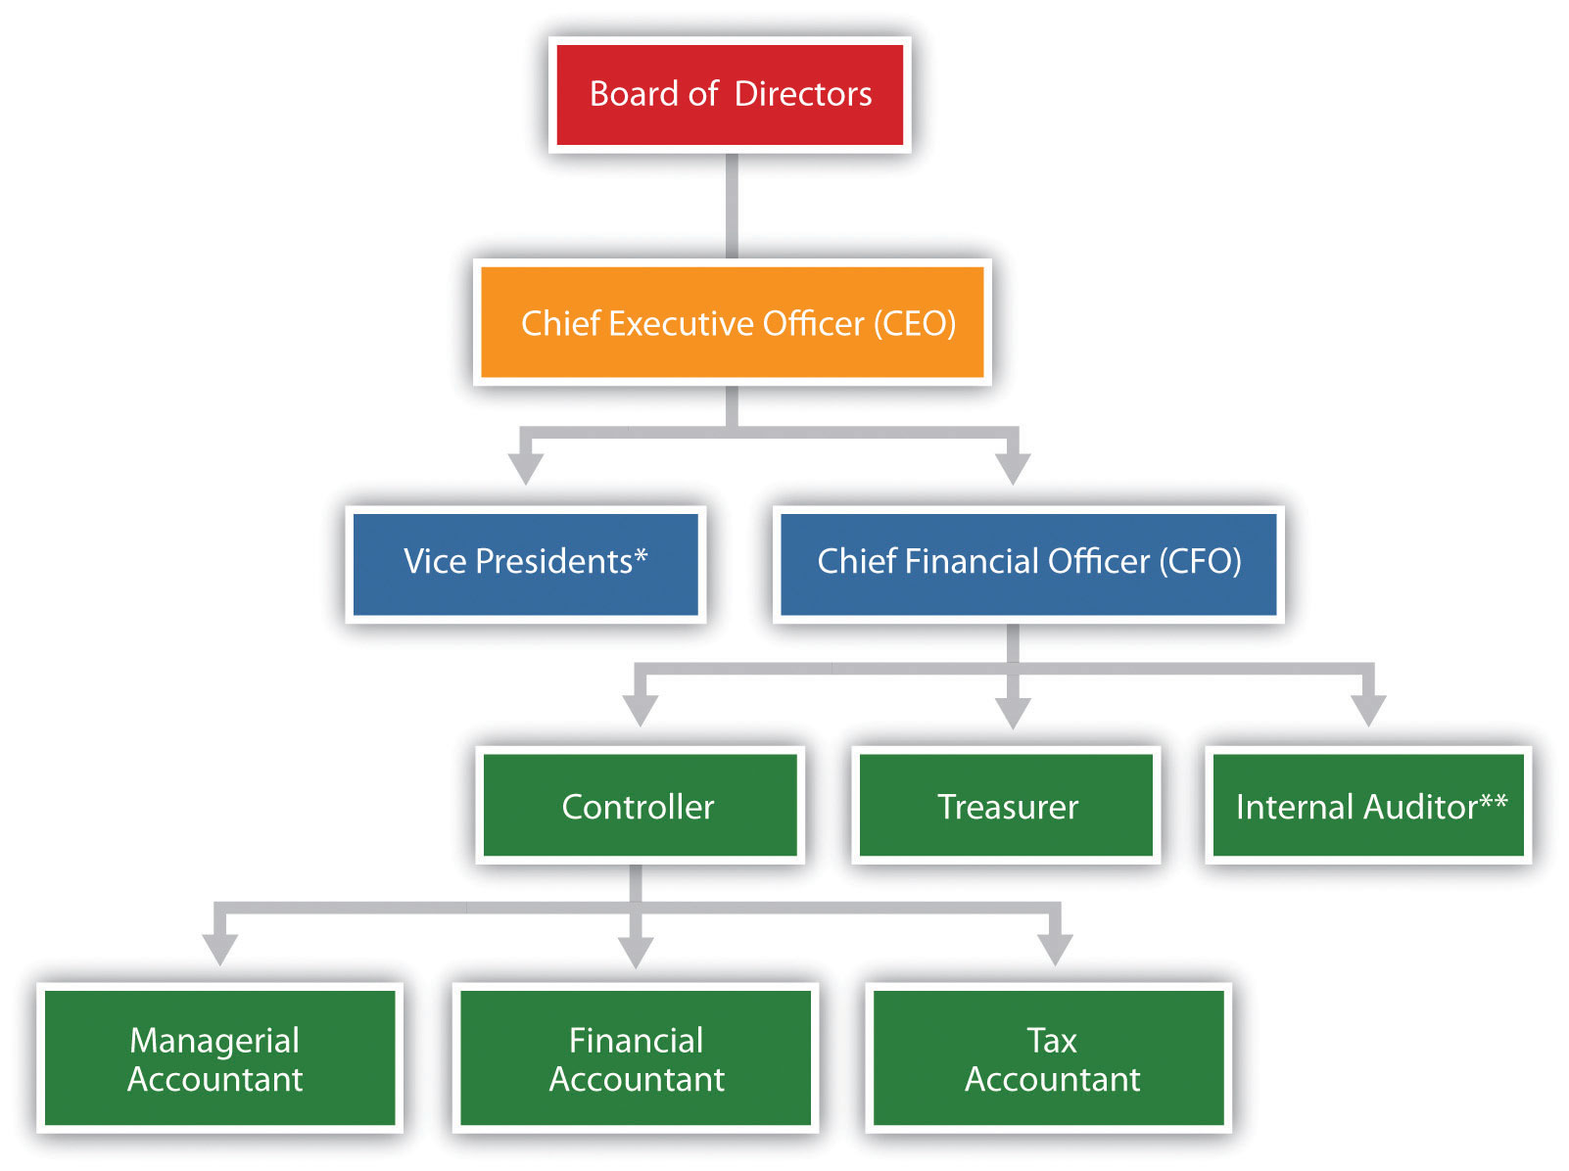

WHO ARE THE END USERS?

Slide 7

OUR SOLUTION AND ITS VALUE PROPOSITION
Conditional formatting- To find the missing values.
Filter- To remove the missing values
Formula- To find the performance of employees
Pivot table- Summary
Graph- Data visualization

Slide 8
DATASET DESCRIPTION
Employee dataset:- Kaggle
Total no. of features-26
No. of features used- 9
Employee ID- Numerical values
Name- Text
Employee type
Performance level
Gender- Male, Female
Employee rating- Numerical values

Slide 9

THE "WOW" IN OUR SOLUTION
Performance level=IFS(Z8>=5,’’VERY HIGH’’, Z8>=4, ‘’HIGH’’, Z8>=3,’’MED’’, TRUE,’’LOW’’)
Created dynamic dashboards with Excel’s pivot tables, slicers and interactive charts. This allows stakeholders to slice and dice data effortlessly, filtering by department, time periods or performance level with a simple click.
3/21/2024 Annual Review
9

Slide 10
MODELLING
STEP 1: DATA COLLECTION AND ORGANIZATION
Gathering the data on employees and organizing
them in excel with the following columns:
Employee ID
First name
Last name
Business unit
Employee status
Employee type
Gender
Employee rating
Performance level
10

Slide 11
STEP 2: DATA CLEANING Handle missing data- Use excel functions to find out the missing values and remove the incomplete entries. STEP 3: PERFORMANCE DASHBOARDS Interactive dashboards- Create an interactive performance dashboard using slicers and pivot tables. STEP 4: DATA VISUALIZATION Pivot tables and pivot charts- Create pivot tables to summarize data by department, job role or time periods. Trend analysis- Use line charts to visualize performance levels.

Slide 12
RESULTS
12

Slide 14
CONCLUSION Employee performance analysis using MS Excel offers a flexible solution for the organizations to improve ad access employee efficiency and productivity. We can conclude that medium performing employees are higher in number as compared to high and very high employees. The low and medium employees need to be motivated and given various tasks as per their performance and strengths.

